Slide 1
Providing Reading Interventions for Students in Grades 4–9 IES Practice Guide
Anita L. Archer, Ph.D. May 26, 2022
©Voyager Sopris Learning. All rights reserved.

Slide 2
Connect With Us
@VoyagerSoprisLearning
@voyagersopris
@VoyagerSoprisLearning
@voyagersopris

Slide 3
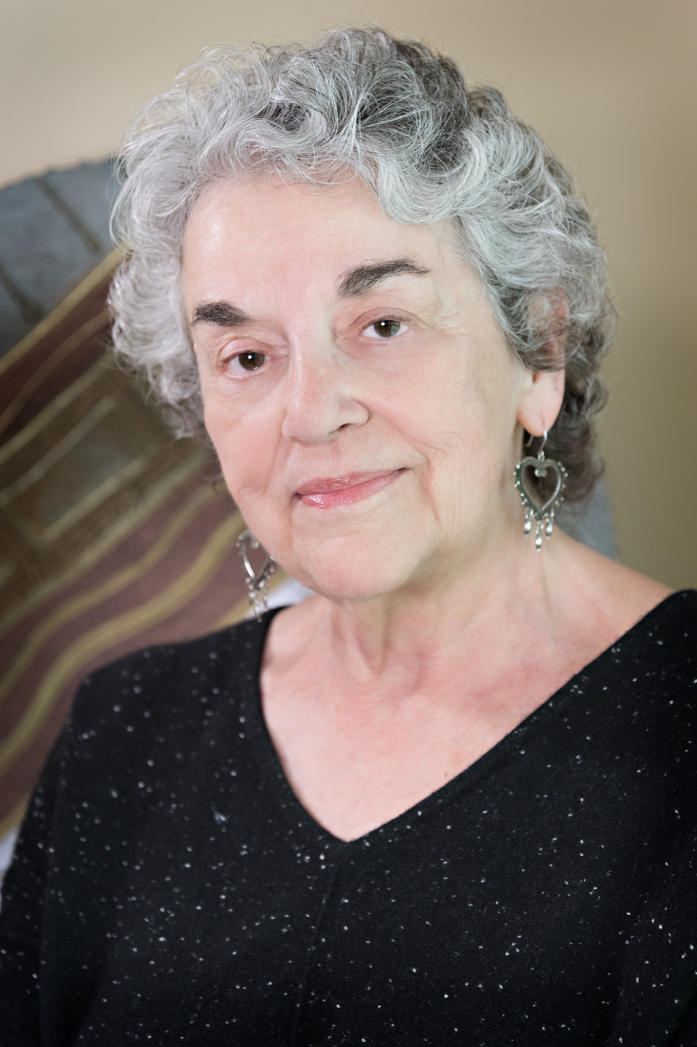
Your Presenter
Dr. Anita Archer
Author or REWARDS short-term intervention curriculum
Educational Expert and Consultant to State Departments and School Districts on Explicit Instruction and Literacy
Faculty Member at Three Universities
Published Author
Recipient of 10 Awards Honoring Her Excellence in Teaching and Contributions to Education

Slide 5
Goals of Webinar
Introduce you to IES Practice Guides
Lead a book-study on the newest IES Practice Guide
Illustrate the recommendations with examples
Full Disclosure—Senior Author of
REWARDS® Intermediate (Voyager/Sopris)
REWARDS® Secondary (Voyager/Sopris)
REWARDS® Plus—Social Studies (Voyager/Sopris)
REWARDS® Plus—Science (Voyager/Sopris)
Phonics for Reading (Levels 1, 2, 3) Curriculum Associates

Slide 6
Recommendations in this practice guide:
Build students’ decoding skills so they can read complex multisyllabic words. Strong Level of Evidence
Provide purposeful fluency-building activities to help students read effortlessly. Strong Level of Evidence
Routinely use a set of comprehension-building practices to help students make sense of the text. Strong Level of Evidence
Provide students with opportunities to practice making sense of stretch text (i.e., challenging text) that will expose them to complex ideas and information. Moderate Level of Evidence

Slide 7
Recommendation 1: Build students’ decoding skills so they can read complex multisyllabic words
Why?
Multisyllabic words increase in frequency in intermediate and middle school grades.
Multisyllabic words often carry the meaning of the text.
Students need a strategy to assist them in breaking down and decoding unfamiliar words.
Many benefits: ability to read unfamiliar words
confidence, interest, and motivation

Slide 8
Recommendation 1: Build students’ decoding skills so they can read complex multisyllabic words
How-to Step 1: Identify the level of students’ word-reading skills in the intervention group and teach vowel and consonant letter-sounds and combinations, as necessary.
How-to Step 2: Teach students a routine (strategy) they can use to decode multisyllabic words.
How-to Step 3: Embed spelling instruction in the lesson.
How-to Step 4: Engage students in a wide array of activities that allow them to practice reading multisyllabic words accurately and with increasing automaticity.

Slide 9
Recommendation 1: Build students’ decoding skills so they can read complex multisyllabic words
How-to Step 1: Identify the level of students’ word-reading skills in the intervention group and teach vowel and consonant letter-sounds and combinations, as necessary.

Slide 10
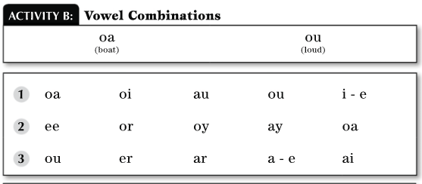
Recommendation 1: Build students’ decoding skills so they can read complex multisyllabic words
How-to Step 1: Identify the level of students’ word-reading skills in the intervention group and teach vowel and consonant letter-sounds and combinations, as necessary.

Slide 11
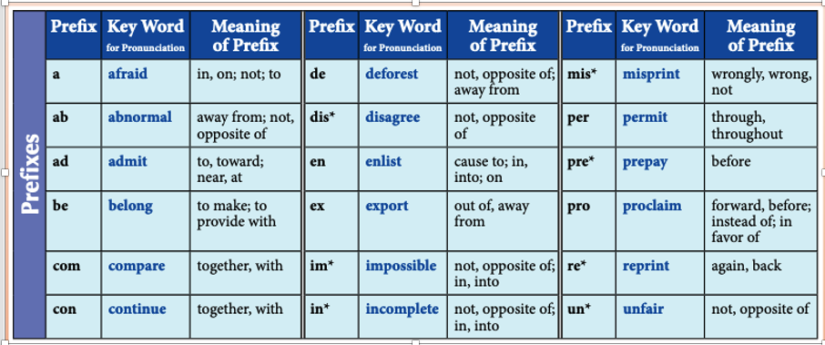
Recommendation 1: Build students’ decoding skills so they can read complex multisyllabic words
How-to Step 1: Identify the level of students’ word-reading skills in the intervention group and teach vowel and consonant letter-sounds and combinations, as necessary.
Preteach pronunciation of prefixes and suffixes.

Slide 12
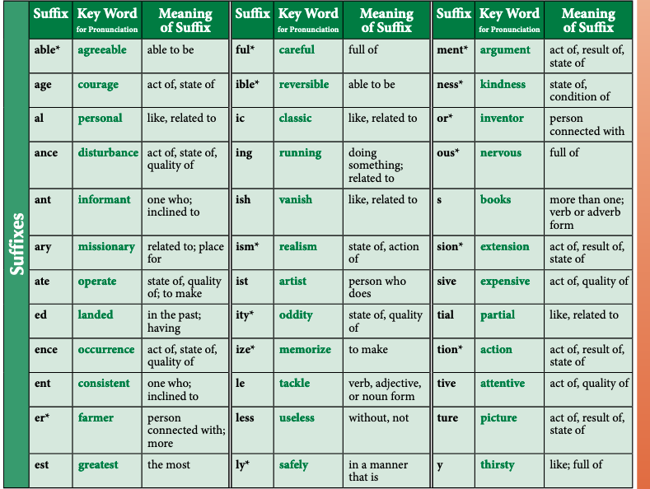
Recommendation 1: Build students’ decoding skills so they can read complex multisyllabic words

Slide 13
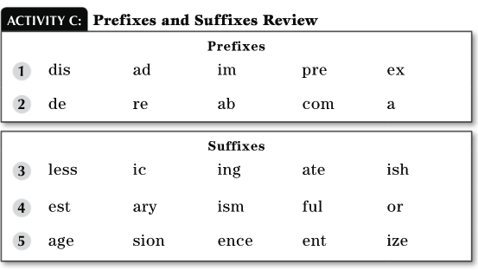
Recommendation 1: Build students’ decoding skills so they can read complex multisyllabic words
How-to Step 1: Identify the level of students’ word-reading skills in the intervention group and teach vowel and consonant letter-sounds and combinations, as necessary.

Slide 14
Recommendation 1: Build students’ decoding skills so they can read complex multisyllabic words
How-to Step 2: Teach students a routine they can use to decode multisyllabic words.
Choose one routine.
Choose a routine that provides simple steps for breaking a word into parts and blending the parts into a word.
Provide explicit instruction:
Model the routine I do it.
Provide guided practice We do it.
Independent practice You do it.

Slide 15
Recommendation 1: Build students’ decoding skills so they can read complex multisyllabic words
How-to Step 2: Teach students a routine they can use to decode multisyllabic words.

Slide 16
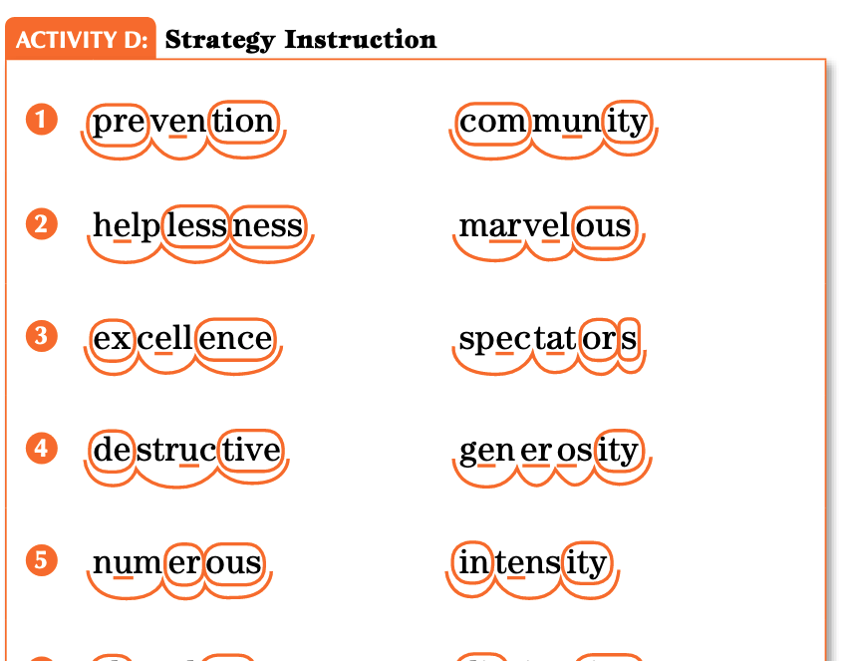
Recommendation 1: Build students’ decoding skills so they can read complex multisyllabic words
How-to Step 2: Teach students a routine they can use to decode multisyllabic words.

Slide 17
Recommendation 1: Build students’ decoding skills so they can read complex multisyllabic words
How-to Step 2: Teach students a routine they can use to decode multisyllabic words.

Slide 18
Recommendation 1: Build students’ decoding skills so they can read complex multisyllabic words
How-to Step 3: Embed spelling instruction in the lesson.
Dictation of multisyllabic words. (REWARDS)
Teacher dictates the spelling word. (inventiveness)
Repeat spelling word.
Segment into oral syllables.
Say the oral syllables as you write the word.
Compare spelling to correct spelling. inventiveness
Cross-out and rewrite word correctly.

Slide 19
Recommendation 1: Build students’ decoding skills so they can read complex multisyllabic words
How-to Step 4: Engage students in a wide array of activities that allow them to practice reading multisyllabic words accurately and with increasing automaticity.
Provide practice reading multisyllabic words in:
Isolation
Sentences
Passages

Slide 20
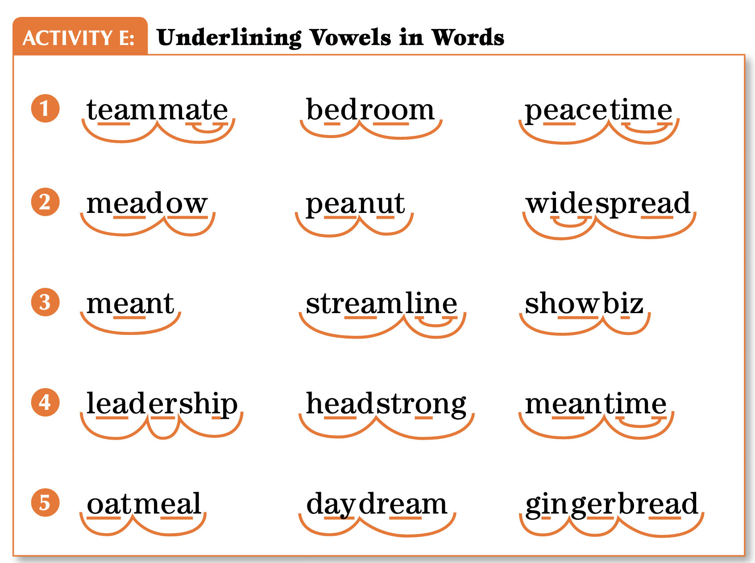
Recommendation 1: Build students’ decoding skills so they can read complex multisyllabic words
How-to Step 4: Engage students in a wide array of activities that allow them to practice reading multisyllabic words accurately and with increasing automaticity.
Provide practice reading multisyllabic words in:
Isolation

Slide 21
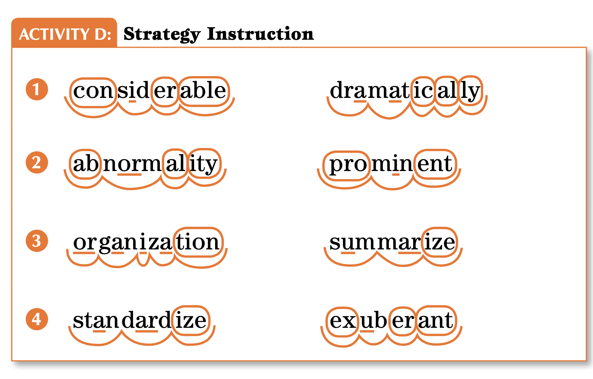
Recommendation 1: Build students’ decoding skills so they can read complex multisyllabic words
How-to Step 4: Engage students in a wide array of activities that allow them to practice reading multisyllabic words accurately and with increasing automaticity.
Provide practice reading multisyllabic words in:
Isolation

Slide 22
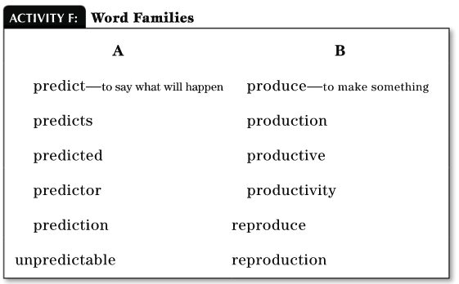
Recommendation 1: Build students’ decoding skills so they can read complex multisyllabic words
How-to Step 4: Engage students in a wide array of activities that allow them to practice reading multisyllabic words accurately and with increasing automaticity.
Provide practice reading multisyllabic words in
Isolation

Slide 23
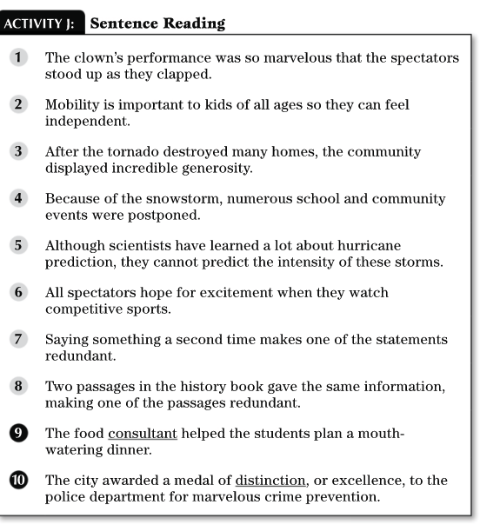
Recommendation 1: Build students’ decoding skills so they can read complex multisyllabic words
How-to Step 4: Engage students in a wide array of activities that allow them to practice reading multisyllabic words accurately and with increasing automaticity.
Provide practice reading multisyllabic words in:
Sentences

Slide 24
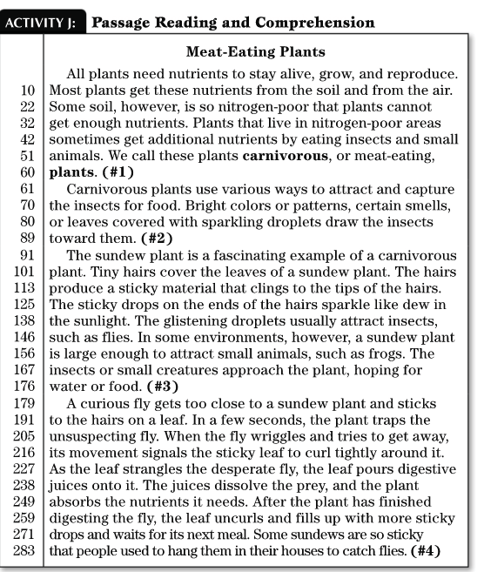
Recommendation 1: Build students’ decoding skills so they can read complex multisyllabic words
How-to Step 4: Engage students in a wide array of activities that allow them to practice reading multisyllabic words accurately and with increasing automaticity.
Provide practice reading multisyllabic words in:
Passages

Slide 25
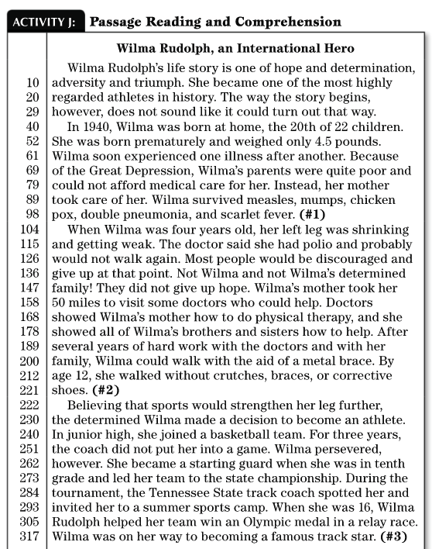
Recommendation 1: Build students’ decoding skills so they can read complex multisyllabic words
How-to Step 4: Engage students in a wide array of activities that allow them to practice reading multisyllabic words accurately and with increasing automaticity.
Provide practice reading multisyllabic words in:
Passages

Slide 26
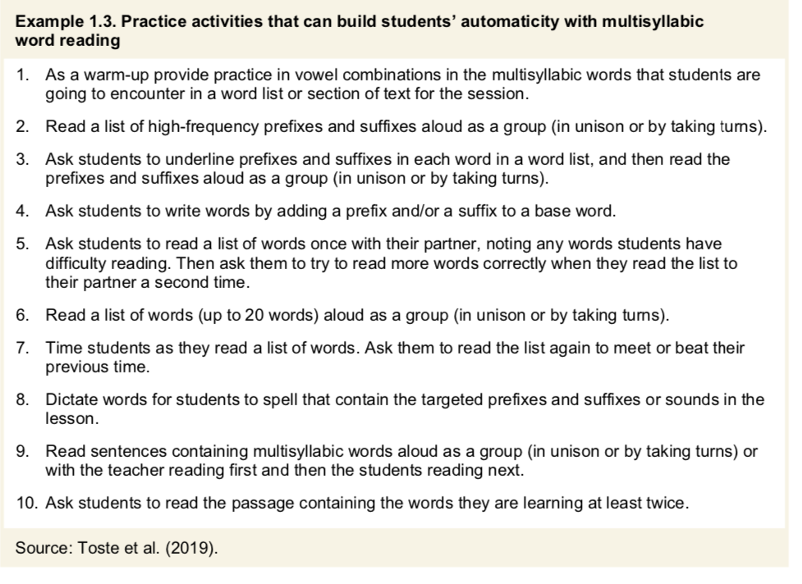

Slide 27
Recommendation 2: Provide purposeful fluency-building activities to help students read effortlessly
How-to Step 1: Provide a purpose for each repeated reading.
How-to Step 2: Focus some instructional time on reading with prosody. How-to Step 3: Regularly provide opportunities for students to read a wide range of texts.

Slide 28
Recommendation 2: Provide purposeful fluency-building activities to help students read effortlessly
Fluency is the ability to read text accurately with ease, expression, and appropriate pacing.
When students read fluently, they can turn their attention from sounding out the individual words to making sense of what they are reading.
Three fluency building activities:
Repeated reading with a specified purpose
Prosody (reading with expression) instruction
Reading a variety of texts
Types of reading:
Silent reading (Whisper Reading)
Partner reading
Choral reading

Slide 29
Recommendation 2: Provide purposeful fluency-building activities to help students read effortlessly
How-to Step 1: Provide a purpose for each repeated reading.
Choose short, content-rich passages
Multisyllabic words
Vocabulary that has been taught
Read same passage 3–4 times
Read each for a different purpose
Read with appropriate pace
Read with expression
Read to respond to questions
Identify words you don’t know
Reflect on what you learned from the passage

Slide 30
Recommendation 2: Provide purposeful fluency-building activities to help students read effortlessly
How-to Step 2: Focus some instructional time on reading with prosody.
Prosody refers to reading with expression, appropriate pitch and tempo, and pauses at the right places.
Teach students to pause at commas, stop at periods, raise or lower their voice when encountering a question mark, and show emotion when encountering an exclamation mark.

Slide 31
Recommendation 2: Provide purposeful fluency-building activities to help students read effortlessly
How-to Step 3: Regularly provide opportunities for students to read a wide range of texts
- Each text is read only once.
- Variety of:
- topics
- sentence structures
- writing styles
- unfamiliar words

Slide 32
Recommendation 3: Comprehension building Routinely use a set of comprehension-building practices to help students make sense of the text.
Recommendation 3 Routinely use a set of comprehension-building practices to help students make sense of the text.
Part A: Build students’ world and word knowledge so they can make sense of the text.
Part B: Consistently provide students with opportunities to ask and answer questions to better understand the text they read.
Part C: Teach students a routine for determining the gist of a short section of text.
Part D: Teach students to monitor their comprehension as they read.

Slide 33
Recommendation 3, Part A: Build students’ world and word knowledge so they can make sense of the text
How-to-Step 1. Develop world knowledge that is relevant for making sense of the passage.
Students need enough knowledge about a topic to read and understand a text on that topic.
Provide 3 to 5 minute introduction on the topic.
Read an easier-to-read description.
Watch a short video clip
Presentation with illustrations

Slide 34
Recommendation 3, Part A: Build students’ world and word knowledge so they can make sense of the text.
How-to-step 2. Teach the meaning of a few words that are essential for understanding the passage.
Identify essential words that are critical and conceptually central for understanding the passage but are likely to be difficult for students.
Before reading:
Select one or two of the essential words.
Provide a simple, brief definition.
Provide an example, non-example, or visual representation of the word.

Slide 35
Recommendation 3, Part A: Build students’ world and word knowledge so they can make sense of the text.
How-to-Step 2. Teach the meaning of a few words that are essential for understanding the passage.
During Reading:
Stop and briefly provide the meaning of additional essential words.
After Reading:
Students will need to work with words and their meanings to remember them.

Slide 36
Recommendation 3, Part A: Build students’ world and word knowledge so they can make sense of the text.
How-To-Step 3. Teach students how to derive meanings of unknown words using context.
Underline the unknown word.
Reread the sentence with the unknown word and look for clues in that sentence to figure out the word’s meaning.
Reread sentences surrounding the sentence with the unknown wording and look for clues to figure out the word’s meaning.

Slide 37
Inside/Outside
Strategy – Inside/Outside
INSIDE—Find parts of the word that give you hints about the meaning of the word.
OUTSIDE—Read the sentence. Find hints as to the word’s meaning.
OUTSIDE—Read the surrounding sentences. Find hints as to the word’s meaning.
Ask yourself, “What might the word mean?”
Try the possible meaning in the sentence.
Ask yourself, “Does it make sense?”

Slide 38
Recommendation 3, Part A: Build students’ world and word knowledge so they can make sense of the text.
How-To-Step 4. Teach prefixes and suffixes to help students derive meanings of words.

Slide 39
Prefixes for Second through Fifth Grades O’Connor, 2014
Prefix | Meaning | Examples
un-, dis-, in- | not | uncoil, unaware, disloyal, dislike, invisible, incomplete
re- | again | redo, resurface
en-, em | to make | enlarge, embolden
non- | not | nonsense, nonbinding
in- | in | Inland, inlaid
mis- | wrong | misspell, misidentify
sub- | under | submarine, subzero
pre- | before | preschool, precaution
im- ir-, il- | not | imperfect, irrelevant, illegal
inter | between | interstate, interpersonal
fore- | before | foreshadow, forejudge
de- | negate, away from | degrease, declaw
trans- | across | transatlantic, transpolar
super-, out, over | excess | Superman, supermarket, outperform, overflow
semi- | half | semicircle, semiliterate
anti- | against | anticlimax, antihero
mid- | In the middle | midnight, midpoint
bi- | two | bicolor, bicycle

Slide 40
Prefixes for Intermediate through Secondary Grades O’Connor, 2014
Prefix | Meaning | Examples
ab- | from | abduct, abnormal, aberration
multi- | many | Multiple, multifaceted, multiplex
hydro- | water | hydropower, hydroplane, hydrology
auto- | self | automobile, autobiography, autoimmune
post- | after | postgraduate, postseason, postgame
pro- | forward | promote, procrastinate, procure
dia- | through, across | dialogue, diagnosis, diaper, diagram
kilo- | thousand | kilometer, kilogram, kilovolt
mega- | large, million | megalopolis, megadose, megavitamin
inter- | between | interstate, interpersonal

Slide 41
Suffixes for Second through Fifth Grades O’Connor, 2014
Suffix | Meaning | Examples
-er, -or | one who, something that | worker, teacher, computer, actor
-ly | in the manner of (creates an adverb) | friendly, gladly
-ful | full of | wonderful, spiteful
-ness | with | kindness, happiness
-less | without | matchless, childless
-tion, -sion | creates the noun form | construction, subtraction, television, repression
-ment | creates the noun form | government, enjoyment
-able, -ible | able to, adjective | dependable, visible
-al | forms nouns from verbs | refusal, denial
-y | inclined to be (creates an adjective) | funny, juicy
-ity | creates the noun form | equality, electricity
-ive | creates adjective | decisive, expressive
-en | creates an adjective | oaken, golden
-ent, ant | creates noun or adjective | pleasant, attendant, different, president
-ous | full of | adventurous, nervous
-ian, ist | one who studies | librarian, historian, colorist, violinist

Slide 42
Suffixes Intermediate through Secondary Grades O’Connor, 2014
Suffix | Meaning | Examples
-acious | Inclined to | fallacious, loquacious, audacious
-ance, ence | state of | annoyance, resistance, violence
-etic | relating to | sympathetic, alphabetic, athletic
-ify | to make | terrify, satisfy, falsify
-itis | inflammation | arthritis, bronchitis, appendicitis
-ling | small | duckling, yearling, halfling
-ology | the study of | bacteriology, dermatology, paleontology
-oid | resembling | humanoid, asteroid, planetoid
-ward | direction | skyward, onward, upward
-wise | In the direction of | lengthwise, clockwise, counterclockwise

Slide 43
Recommendation 3, Part A: Build students’ world and word knowledge so they can make sense of the text.
How-To-Step 5. Teach the meaning of Latin and Greek roots.

Slide 44
Common Latin and Greek Roots
aqua | water | Greek | aquarium, aqueduct, aquaculture, aquamarine, aquaplane, aquatic
aud | hearing | Latin | audio, audition, audiovisual, auditorium, audiotape, inaudible
auto | self | Greek | autograph, autobiography, automobile, autocrat, autonomy
astro | star | Greek | astronomy, astrophysics, astrology, astronaut, astronomer, asterisk
biblio | book | Greek | Bible, bibliography, bibliophobia, bibliophile, biblioklept
bio | life | Greek | biography, biology,autobiography, bionic, biotic, antibiotic, biome, bioshere, biometrics
chrono | time | Greek | synchronize, chronology,chronic, chronicle, anachronism
corp | body | Latin | corpse, corporation, corps,incorporate, corporeal, corpulence
demo | the people | Greek | democracy, demography,epidemic, demotic, endemic, pandemic
dic, dict | speak, tell | Latin | dictate, dictation, diction, dictator, verdict, predict, contradict, benediction, jurisdiction, predict, indict, edict
dorm | sleep | Latin | dormant, dormitory, dormer, dormouse, dormition, dormitive
geo | earth | Greek | geology, geologist, geometry, geography, geographer, geopolitical, geothermal, geocentric

Slide 45
Common Latin and Greek Roots
graph | to write, to draw | Greek | autograph, biography, photograph, telegraph, lithograph
hydro | water | Greek | hydroplane, dehydrate, hydroelectric, hydrogen, hydrophone
ject | throw | Latin | reject, deject, project, inject, injection, projection
logos, logy | study | Greek | geology, astrology, biology, numerology, zoology, technology, psychology, anthropology, mythology
luna | moon | Latin | lunar, lunacy, lunatic, interlunar
meter | measure | Greek | meter, thermometer, diameter, geometry, optometry, barometer, centimeter, symmetry, voltammeter
mega | great, large, big | Greek | megaphone,megalith, megalomania, megatons, megalopolis
min | small, little | Latin | minimal, minimize, minimum, mini, miniature, minuscule, minute, minority
mit, mis | send | Latin | mission, transmit, transmission, remit, missile,submission, permit, emit, emissary
path | feeling, suffering | Greek | pathetic, pathology, apathy, antipathy, sympathy, telepathy, empathy, sociopath
ped | foot | Latin | pedestrian, pedal, peddle, peddler, pedicure, pedometer
philia | love, friendship | Greek | philosopher, Philadelphia, philanthropist, philharmonic, Philip

Slide 46
Common Latin and Greek Roots
phono | sound | Greek | phonograph, microphone, symphony, telephone, phonogram, megaphone, phony, euphony, xylophone, phony,
photo | light | Greek | photograph, photosynthesis, telephoto, photometer, photophilia
port | carry | Latin | port, transport, transportation, portable, portage, report
spect | see | Latin | respect, inspection, inspector, spectator, spectacles,prospect
scope | look at | Greek | microscope, telescope, periscope, kaleidoscope, episcopal
sol | sun | Latin | solar, solar system, solstice, solarium, parasol
struct | build, form | Latin | instruct, instruction, construction, reconstruction, destruct, destruction, infrastructure, construe, instrument, instrumental
tele | distant | Greek | telephone, television,telegraph, telephoto, telescope, telepathy, telethon, telegenic
terra | land | Latin | territory, terrestrial, terrace, terrarium, extraterrestrial, Mediterranean Sea, terra cotta, subterranean

Slide 47
Recommendation 3, Part B: Consistently provide students with opportunities to ask and answer questions to better understand the text they read.
How-To-Step 1. Explicitly teach students how to find and justify answers to different types of questions.
How-To-Step 2. Provide ample opportunities for students to collaboratively answer questions.
How-To-Step 3. Teach students to ask questions about the text while reading.

Slide 48
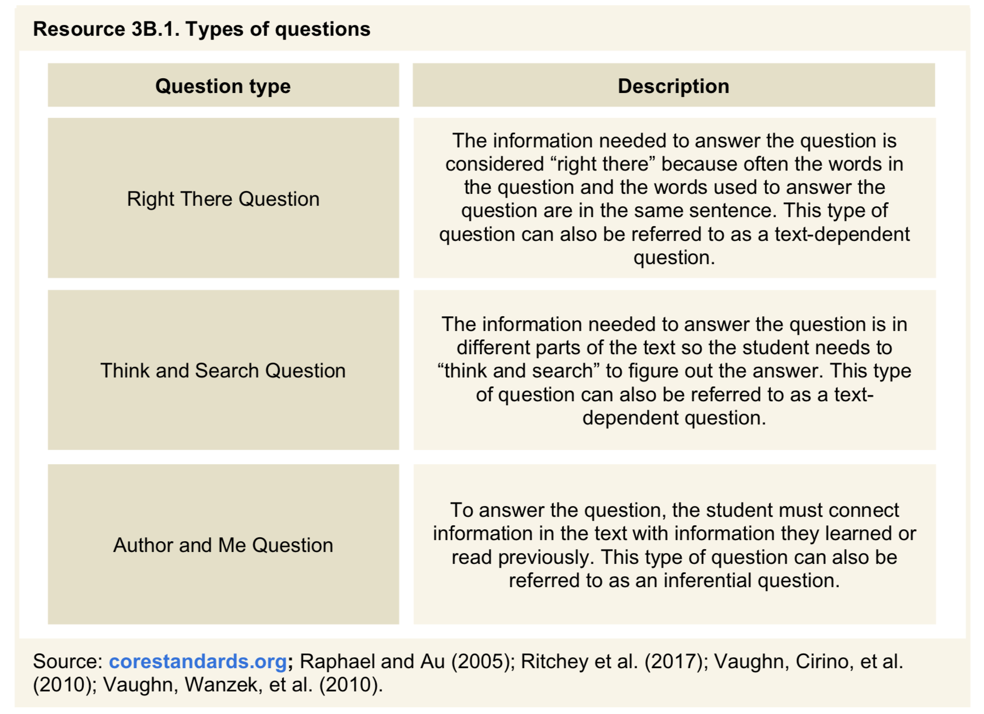
Recommendation 3, Part B: Consistently provide students with opportunities to ask and answer questions to better understand the text they read.
How-To-Step 1. Explicitly teach students how to find and justify answers to different types of questions.

Slide 49
Comprehension Strategy
Paragraph Shrinking Name the who or what. (The main person, animal, or thing.) Tell the most important thing about the who or what. Say the main idea in 10 words or less. (Optional: Record your main idea sentence.) (From the PALS program by Fuchs, Mathes, and Fuchs)

Slide 50
Getting the Gist
Name the who or what the paragraph is about in a brief phrase.
Identify two or three important details about the topic.
“Shrink” the paragraph by stating or writing the main idea. (Say it in 10 to 15 words)
(From Vaughn, et. al. Collaborative Strategic Reading)

Slide 51
Getting the Gist

Slide 52
African Map

Slide 54
British Colonies
United States of America
Became a British Colony in 1607
Independent on July 4, 1776
Kenya
Became British Colony in 1885
Independent Country on December 12, 1963

Slide 55
Learning Intention
Students will be able to write main idea statements that form a summary of an informative article.

Slide 56
Getting the Gist
Name the who or what the paragraph is about in a brief phrase.
Identify two or three important details about the topic.
“Shrink” the paragraph by stating or writing the main idea. (Say it in 10 to 15 words)
(From Vaughn, et. al. Collaborative Strategic Reading)

Slide 57
Model—I do it
Getting the Gist
Name the who or what the paragraph is about in a brief phrase.
Identify two or three important details about the topic.
“Shrink” the paragraph by stating or writing the main idea. (Say it in 10 to 15 words)
(From Vaughn, et. al. Collaborative Strategic Reading)
The Republic of Kenya is a country in East Africa. Ethiopia borders Kenya to the north. Kenya is bordered by Somalia to the northeast, Tanzania to the south, Uganda to the west. On the Southeast is the Indian Ocean.

Slide 58
Model—I do it
Getting the Gist
Name the who or what the paragraph is about in a brief phrase.
Identify two or three important details about the topic.
“Shrink” the paragraph by stating or writing the main idea. (Say it in 10 to 15 words)
(From Vaughn, et. al. Collaborative Strategic Reading)
The Republic of Kenya is a country in East Africa. Ethiopia borders Kenya to the north. Kenya is bordered by Somalia to the northeast, Tanzania to the south, Uganda to the west. On the Southeast is the Indian Ocean.
Kenya, an East African country, is surrounded by four African countries and the Indian Ocean.

Slide 59
We do it
Getting the Gist
Name the who or what the paragraph is about in a brief phrase.
Identify two or three important details about the topic.
“Shrink” the paragraph by stating or writing the main idea. (Say it in 10 to 15 words)
(From Vaughn, et. al. Collaborative Strategic Reading)
Part of their history was a time of problems. At some times, other countries attacked to take over the country. There was much fighting. Kenya was made a British colony. That meant that Kenyans did not rule their own land. The native people of Kenya believed in independence. They did not want to be a colony. It took years, but they got their land back. Kenya became independent in 1963, and the Kenyan people declared not only their independence but formed a country. They took the name Kenya as the name of their country.

Slide 60
We do it
Getting the Gist
Name the who or what the paragraph is about in a brief phrase.
Identify two or three important details about the topic.
“Shrink” the paragraph by stating or writing the main idea. (Say it in 10 to 15 words)
(From Vaughn, et. al. Collaborative Strategic Reading)
Part of their history was a time of problems. At some times, other countries attacked to take over the country. There was much fighting. Kenya was made a British colony. That meant that Kenyans did not rule their own land. The native people of Kenya believed in independence. They did not want to be a colony. It took years, but they got their land back. Kenya became independent in 1963, and the Kenyan people declared not only their independence but formed a country. They took the name Kenya as the name of their country.
Kenya, once a British colony, became an independent country in 1963.

Slide 61
We do it
Getting the Gist
Name the who or what the paragraph is about in a brief phrase.
Identify two or three important details about the topic.
“Shrink” the paragraph by stating or writing the main idea. (Say it in 10 to 15 words)
(From Vaughn, et. al. Collaborative Strategic Reading)
There are different groups of people in Kenya. It was not one country before it became a colony. Different groups lived in different places and had their own languages and ways of living. After independence, they joined together in one country, but they still have differences. There are different culture groups within Kenya. While they are from the same region they have different histories. Each has its own traditions. Traditions should be respected. While most people in Kenya speak and write in English because of the colonial years, each culture has its own language and history. There still are problems having a united country.

Slide 62
We do it
There are different groups of people in Kenya. It was not one country before it became a colony. Different groups lived in different places and had their own languages and ways of living. After independence, they joined together in one country, but they still have differences. There are different culture groups within Kenya. While they are from the same region they have different histories. Each has its own traditions. Traditions should be respected. While most people in Kenya speak and write in English because of the colonial years, each culture has its own language and history. There still are problems having a united country.
Groups in Kenya have different cultures, traditions, histories, and languages.
Conflict occurs in Kenya because the citizens have different cultures, traditions, histories, and languages.
Getting the Gist
Name the who or what the paragraph is about in a brief phrase.
Identify two or three important details about the topic.
“Shrink” the paragraph by stating or writing the main idea. (Say it in 10 to 15 words)
(From Vaughn, et. al. Collaborative Strategic Reading)

Slide 63
Summary
Kenya, an East African country, is surrounded by four African countries and the Indian Ocean. Kenya, once a British colony, became an independent country in 1963. Conflict occurs in Kenya because the citizens have different cultures, traditions, histories, and languages.

Slide 64
Revised Summary
Kenya, an East African country, is surrounded bordered by four African countries and the Indian Ocean. Kenya, once formally a British colony, became independent an independent country in 1963. Unfortunately, conflict often occurs in Kenya because the citizens tribes have different histories, cultures, traditions, histories, and languages.

Slide 65
Delivery of Instruction
1. Require frequent responses. (verbal, written, action)
Monitor student performance closely. (watch and listen carefully)
Provide immediate affirmative (praise) and informative (corrective) feedback.
Deliver instruction at a brisk pace.

Slide 66
voyagersopris.com/REWARDS

Slide 67
Thank you for attending
Questions
Resources available
Be well and enjoy summer
©Voyager Sopris Learning. All rights reserved.

